Slide 1
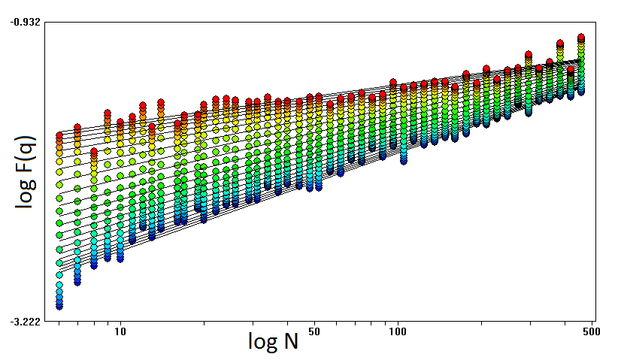
Multifractal behavior of financial time series
Are there similarities between multifractals in different markets?
Do price changes and volume changes in stock market indices
have similar multifractal properties?

Slide 2
Price changes are more complex and lack long-term correlations
Volume changes are less complex with anti-persistent long-term
correlations
Distinct multifractal regimes for price and volume changes?

Slide 3
Multifractal analysis of managed and independent float exchange rates
Questions:
Are there any distinct multifractal behaviors when transitioning from a managed to independent float regime?
If so, what do they represent?

Slide 4
Multifractal analysis of managed and independent float exchange rates
Answers:
transitions to independent float regimes indicate market efficiency
developed countries are more sensitive to changes in currency regimes

