Slide 1
Application of Statistical Physics in Time Series Analysis
Duan Wang
Center for Polymer Studies, Boston University
wangduan@bu.edu
Advisor: H. Eugene Stanley

Slide 2
Outline
Basic Concepts in Financial Time Series
Random Matrix Theory
  Meaning of eigenvalues and eigenvectors
  Eigenvalue distribution for random correlation matrix
  Interpreting empirical eigenvalue distribution
Extensions of Random Matrix Theory
  Autoregressive random matrix theory (ARRMT)
  Time-lag random matrix theory (TLRMT)
  Global factor model (GFM)
(Application of RMT in portfolio optimization)
Notes:
Show the example before outline or after introducing RMT?
At last, introduce other methods in physics that can be used in time series analysis.

Slide 3
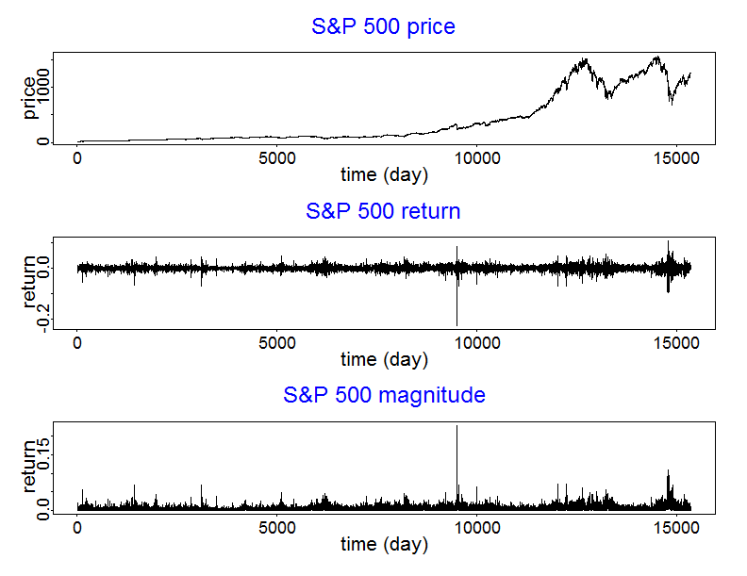

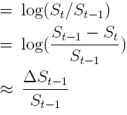

Price, Return and Return Magnitude
2001 internet bubble
Price (S_{i,t} ):
index i at time t
1987 Black Monday
2008 subprime mortgage crisis
1950
2011
Return:
22% price drop
Magnitude of return:
Notes:
You may not feel comfortable about this equation. I will show you what it means.
Magnitude: fluctuation. Measure of uncertainty, in finance uncertainty means risk. That is why it is heavily studied in Finance.
Market crash: always combined with price drop and variance increase.
In econophysics literatures, they often use the word “volatility”, but I avoid using the word volatility here because there are different definitions of volatilities, it would be confusing when we introduce conditional volatility later.

Slide 4


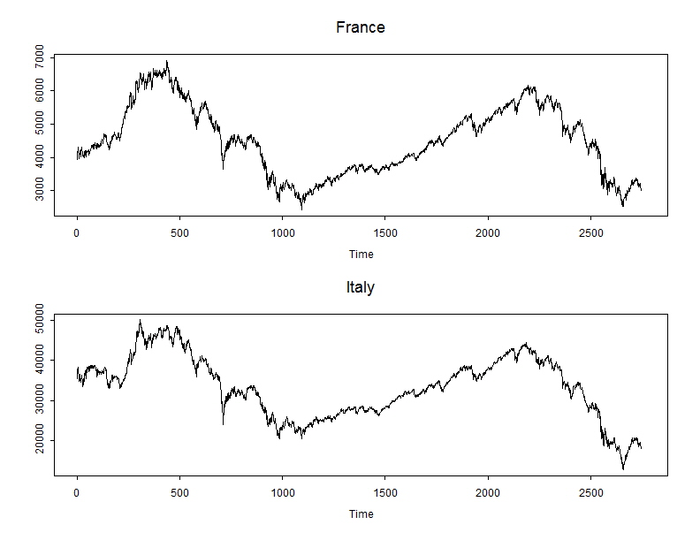

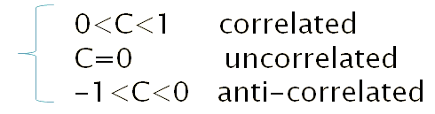
Measure of Dependence: Cross-Correlation, Autocorrelation, and Time-Lag Cross-Correlation
For time series {X_{t}} and {Y_{t}},
Cross-correlation
Autocorrelation
Time-lag Cross-correlation
<> Denotes average
Standard deviations
time lag
Example: highly correlated
France and Italy indices
Properties:
Notes:
Instantaneous
Measures dependence between 2 random variables.

Slide 5
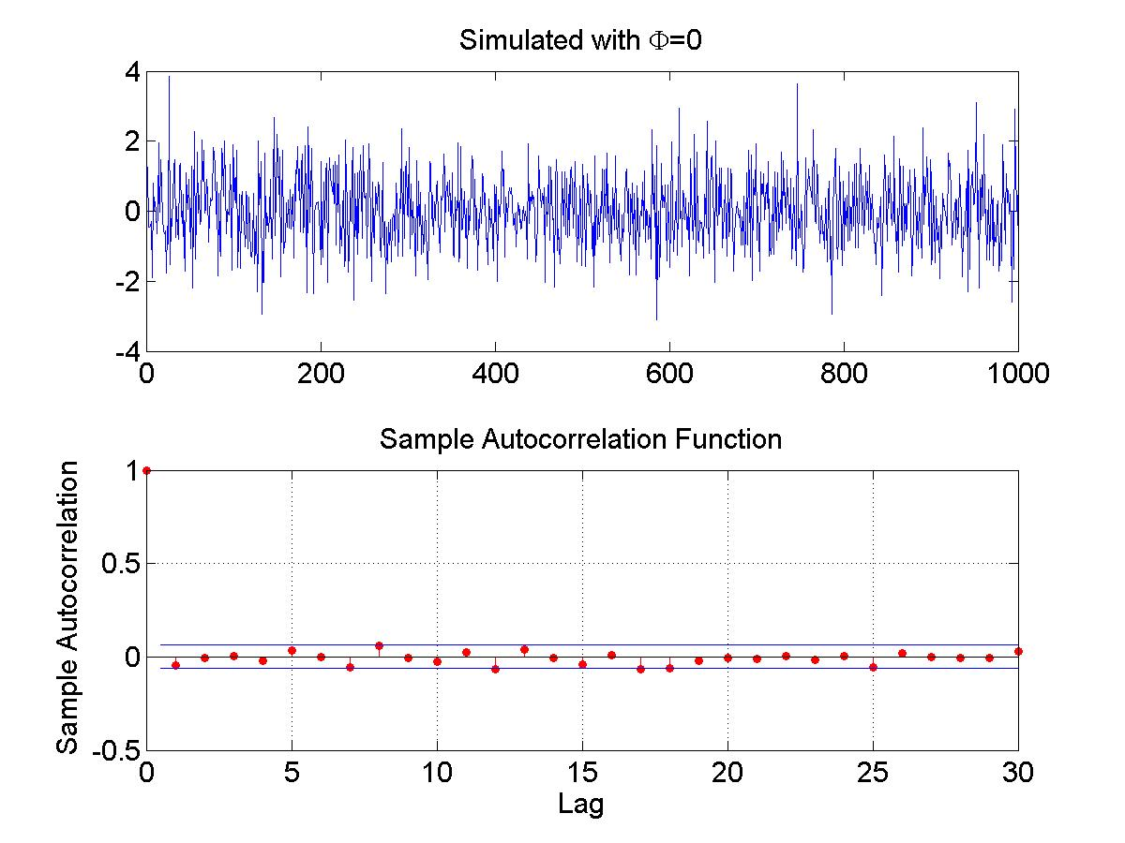


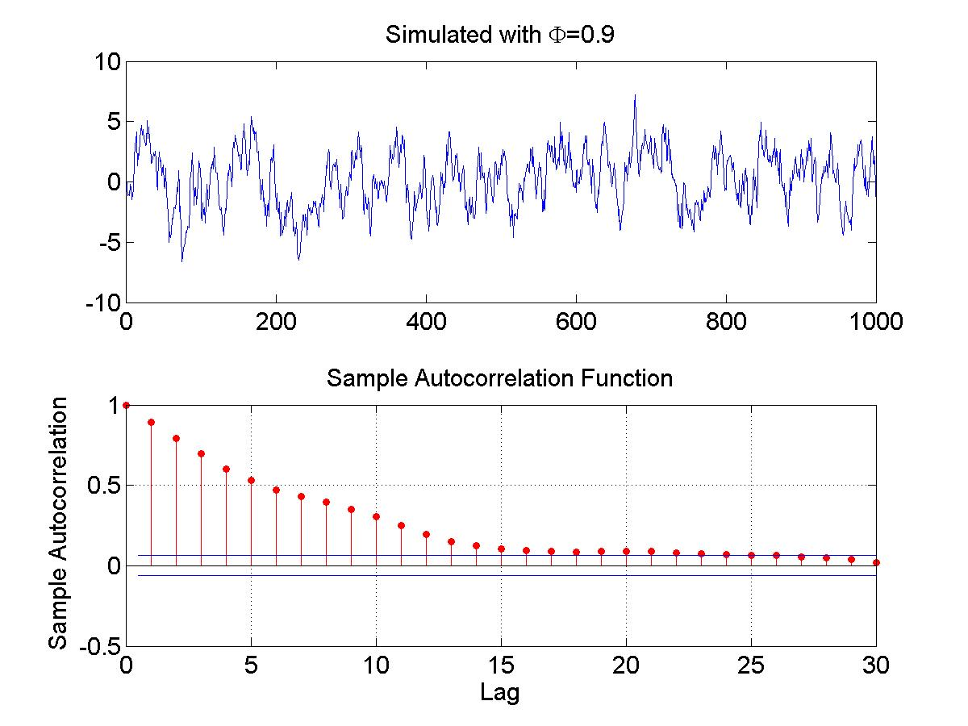
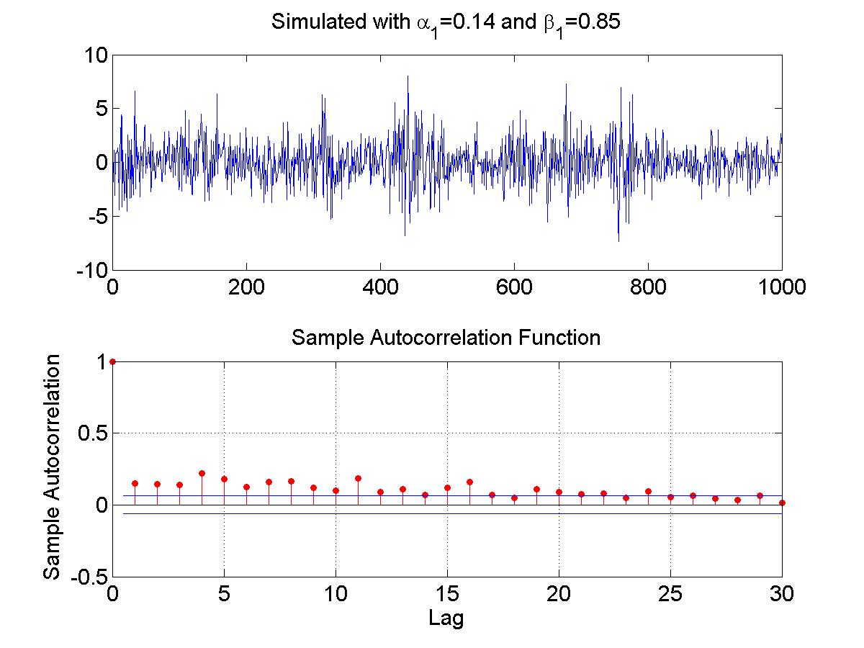
Examples of Return Autocorrelations and Magnitude Autocorrelations
Simulate return autocorrelations: AR(1)
Simulate magnitude autocorrelations:
GARCH(1,1)

Slide 6
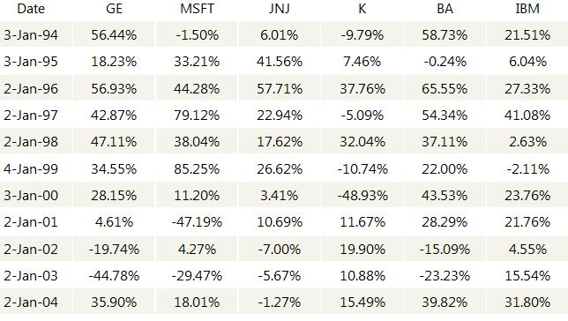
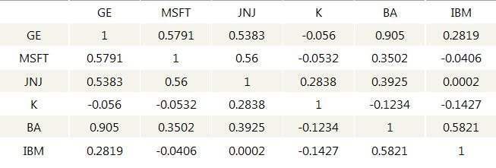

Multiple Time Series
Annual Return of 6 US stocks
6 Stocks
6x6 Correlation matrix
Symmetric matrix
Main diagonal=1
Eigenvalue decomposition
Correlation Matrix
Meaning of eigenvalues?
Explained by random matrix theory (RMT)
Notes:
Joke about Special-K and MSFT
Windows 7 does not sell better when you eat more special-K cereals.
Add definition of correlation matrix 1/t C C^T
Explained by PCA. Figure out. Add a slide if possible.

Slide 7
Original RMT
Aim: find existence of collective behavior
method: compare the eigenvalue distribution between
(1) a symmetric random matrix and
(2) a Hamiltonian matrix
RMT in Econophysics
Aim: find existence of cross-correlation in multiple time series
Method: compare the eigenvalue distribution of
(1) a Wishart matrix (random correlation matrix) and
(2) empirical cross-correlation matrix
Wishart matrix: sample correlation matrix for uncorrelated time series
Notes:
Know definition, in case asked
If not finite length, it is identity matrix.
Add graph: semicircle & RMT for time series, compare the 2.
GOE and Wishart Ensemble
Hamitonian: Kinetic energy operator plus potential energy operator.

Slide 8
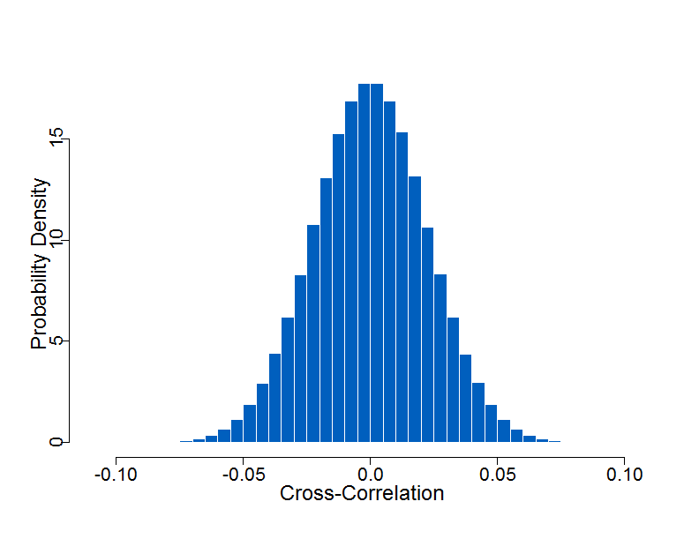
Cross-Correlation between Uncorrelated Finite Length Time Series
Sample cross-correlations between independent time series are not zero
if time series are of finite length.
Mathematically: C_{ij}=0
Statistically: C_{ij} falls in , with 95% probability.
95% confidence interval
Cross-correlation distribution between 2 uncorrelated time series, each with length T=2000.
Sample correlation distribution:
C_{ij}~N(0,1/T)
Gaussian distribution with mean zero and variance 1/T
Notes:
Say something about correlation matrix.
Sample and population.
The main purpose of this slide is to show the correlation of uncorrelated time series.
This graph is to show if 2 time series are uncorrelated.
RMT is aimed to find out if multiple time series are uncorrelated.
Add formula for sample correlation
Small correlation N(0,1/T)

Slide 9


Meaning of Eigenvalues and Eigenvectors
Principal Components
Linear combination of individual time series
Orthogonal transformation of correlated time series
Eigenvectors (Factor Loadings)
Weight of each individual time series in a principal component
Eigenvalues
Variance of each principal component
Measures the significance of a factor
$N$ time series with length $T$
$N$ principal components
Not all of them are significant
Compare them with the eigenvalues of Wishart matrix to find out the number of significant factors
Notes:
Show the example before outline or after introducing RMT?
At last, introduce other methods in physics that can be used in time series analysis.

Slide 10
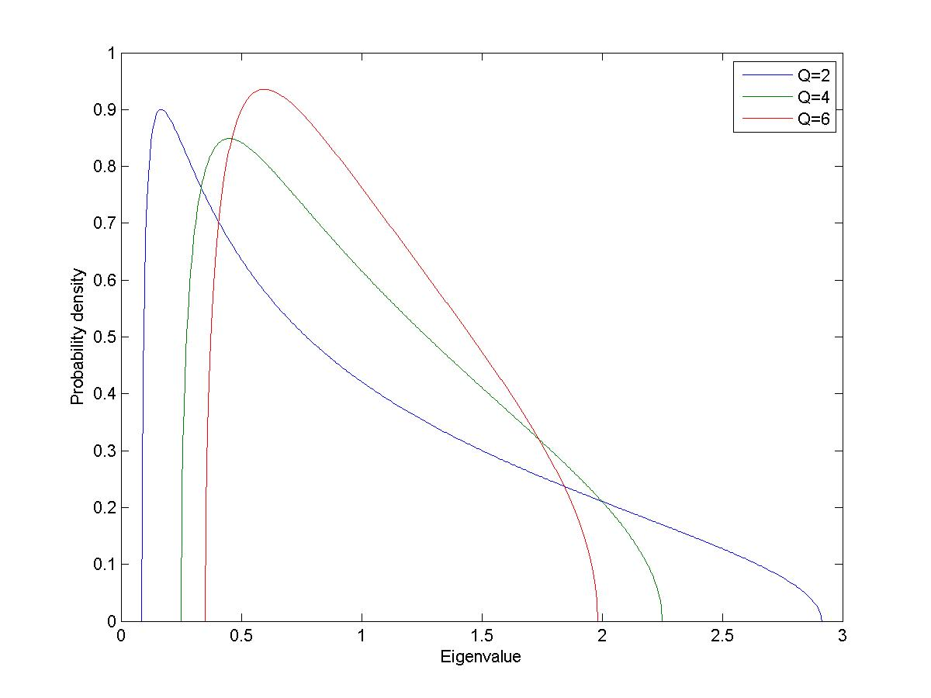

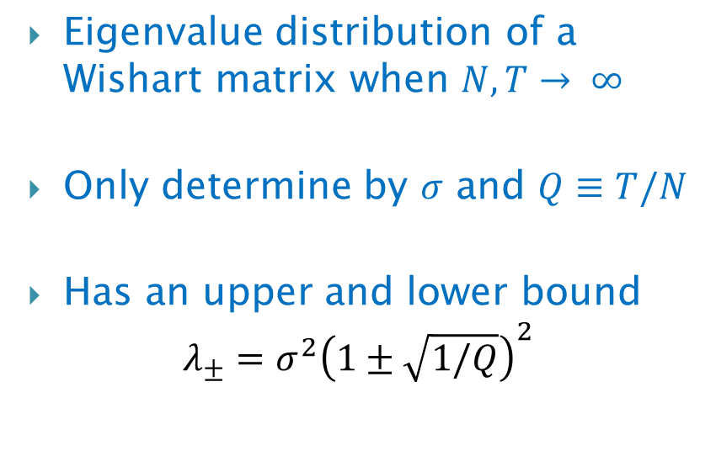
Eigenvalue Distribution for Wishart Matrix
Eigenvalue distribution of a Wishart matrix when $N, T→ ∞$
Only determine by $σ$ and $Q≡T/N$
Has an upper and lower bound
$$λ_{±}=σ^{2}{\left(1±\sqrt{1/Q}\right)}^{2}$$
$$P\left(λ\right)=\frac{Q}{2πσ^{2}} \frac{\sqrt{(λ_{+}−λ)(λ−λ_{−})}}{λ}$$

Slide 11
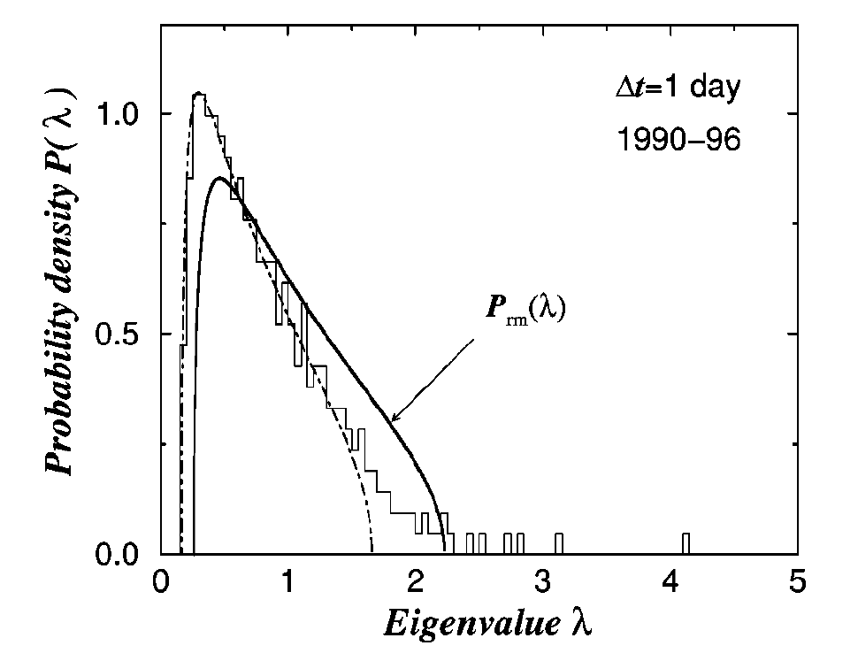
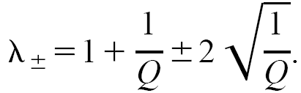

Empirical Eigenvalue Distribution
From: Plerou et. al., 1999, PRL., 2002, PRE. (422 stocks from S&P 500, 1737 daily returns)
Eigenvalue distribution of Wishart matrix
Largest eigenvalue (not shown):
Average behavior
(Bahavior of the whole market)
Significant factors
Other large eigenvalues:
Subgroups
(Sectors, industries, …)
Noise
Largest eigenvalue of uncorrelated time series
Notes:
Know what each line is
Explain: strength of correlation
Explain data
/* There are a rectangle and a eclips in order to block characters and arrow in the graph. */

Slide 12
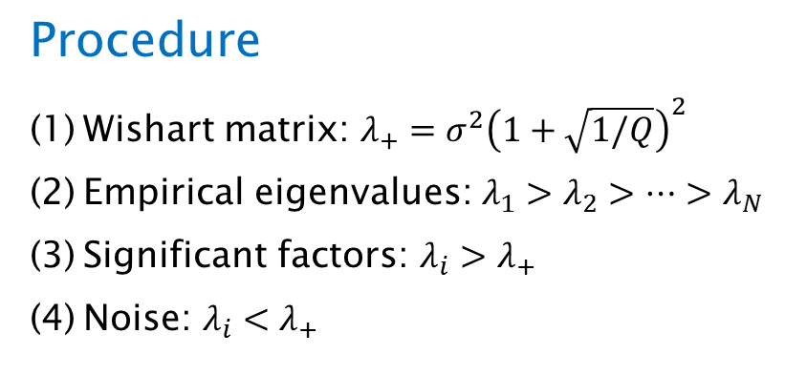
Random Matrix Theory: Summary
Aim
Test significance of correlations in multiple time series
Find number of significant factors
Reduce noise in correlation matrix
Procedure
Wishart matrix: $λ_{+}=σ^{2}{\left(1+\sqrt{1/Q}\right)}^{2}$
Empirical eigenvalues: $λ_{1}>λ_{2}>…>λ_{N}$
Significant factors: $λ_{i}>λ_{+}$
Noise: $λ_{i}<λ_{+}$

Slide 13
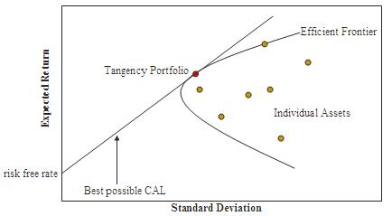
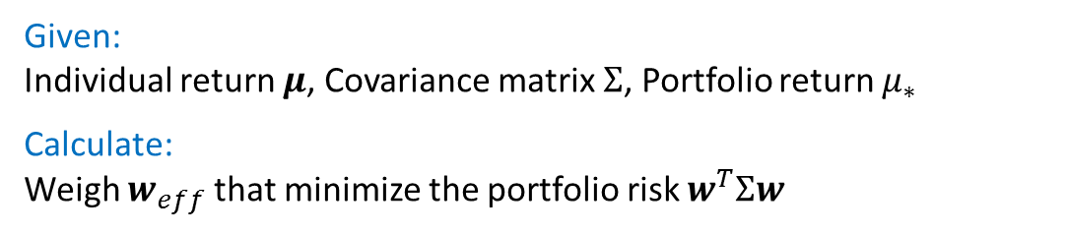
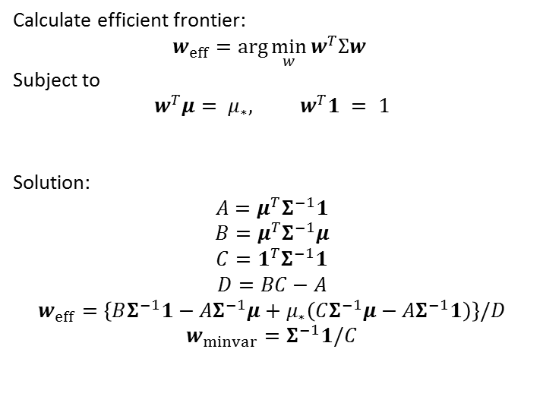
Efficient Frontier
H. Markowitz (1952)
Given:
Individual return $μ$, Covariance matrix $Σ$, Portfolio return $μ_{∗}$
Calculate:
Weigh $w_{eff}$ that minimize the portfolio risk $w^{T}Σw$
Calculate efficient frontier:
$$w_{eff}=\arg{\min_{w}{w^{T}Σw}}$$
Subject to
$$w^{T}μ= μ_{∗}, w^{T}1 = 1$$
Solution:
$$A=μ^{T}Σ^{−1}1$$
$$B=μ^{T}Σ^{−1}μ$$
$$C=1^{T}Σ^{−1}1$$
$$D=BC−A$$
$$w_{eff}=\left\{BΣ^{−1}1−AΣ^{−1}μ+μ_{∗}\left(CΣ^{−1}μ−AΣ^{−1}1\right)\right\}/D$$
$$w_{minvar}=Σ^{−1}1/C$$
Notes:
Add a slide: Diversification. Use GLD and SPY as an example. The return is still better than money market.

Slide 14
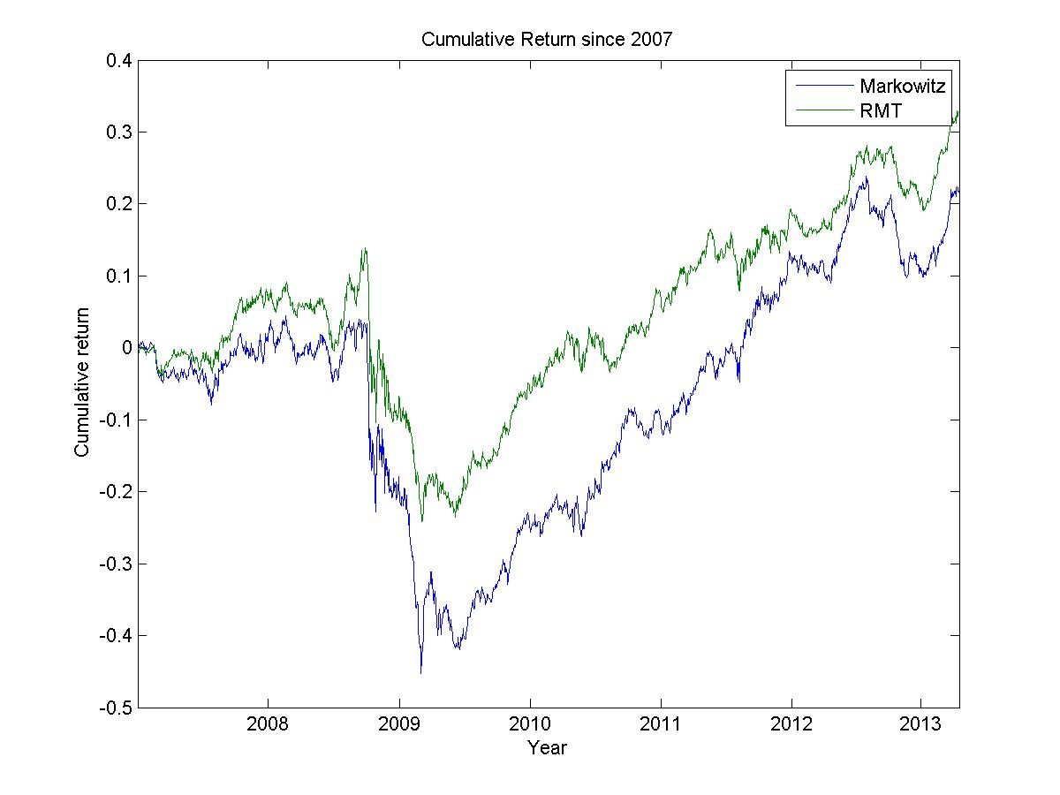
Minimum Variance Portfolio: Cumulative Return
Portfolio:
404 stocks from S&P 500, rebalancing at the end of each year
 | μ | σ
Markowitz | 0.0001443 | 0.0086652
RMT | 0.0002205 | 0.0080505
After Applying RMT in constructing the minimum variance portfolio, we increased returns and reduced risk.
Notes:
Most of the difference come from year 2008-2009. During financial crisis, the correlation become less stable. Get a graph of eigenvalue vs time and find out how it looks like during crisis.

Slide 15
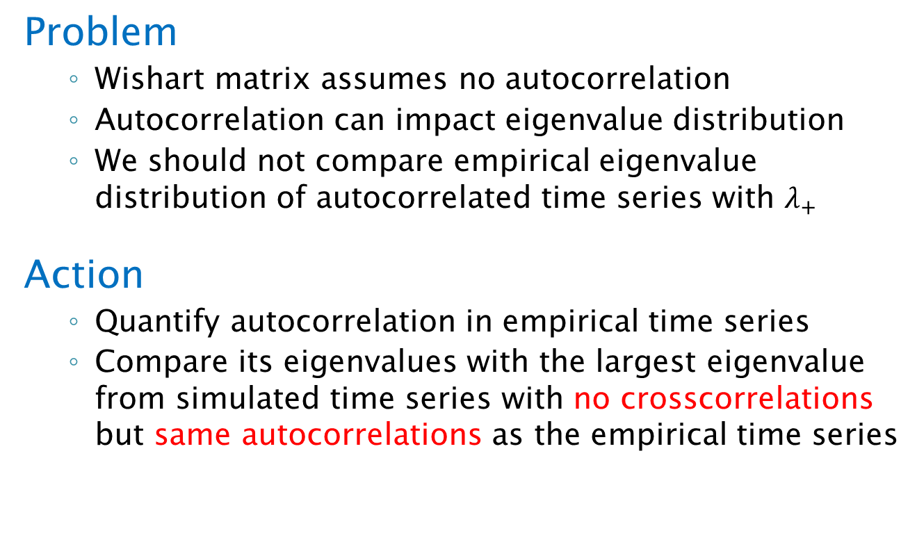
Autogregressive Random Matrix Theory (ARRMT)
Problem
  Wishart matrix assumes no autocorrelation
  Autocorrelation can impact eigenvalue distribution
  We should not compare empirical eigenvalue distribution of autocorrelated time series with $λ_{+}$
Action
  Quantify autocorrelation in empirical time series
  Compare its eigenvalues with the largest eigenvalue from simulated time series with no crosscorrelations but same autocorrelations as the empirical time series
Notes:
Show the example before outline or after introducing RMT?
At last, introduce other methods in physics that can be used in time series analysis.

Slide 16
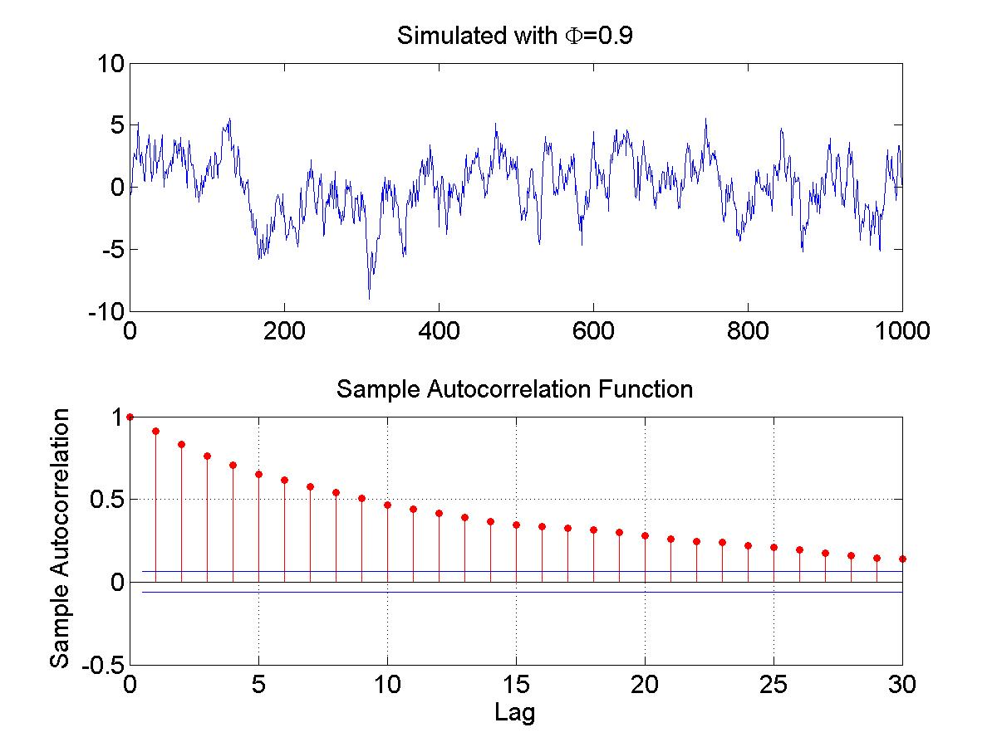

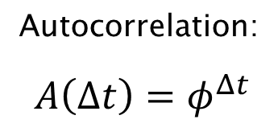
Quantify Autocorrelation:
First Order Autoregressive Model (AR(1))
AR(1) Model:
Autocorrelation:
$$A\left(Δt\right)=φ^{Δt}$$

Slide 17
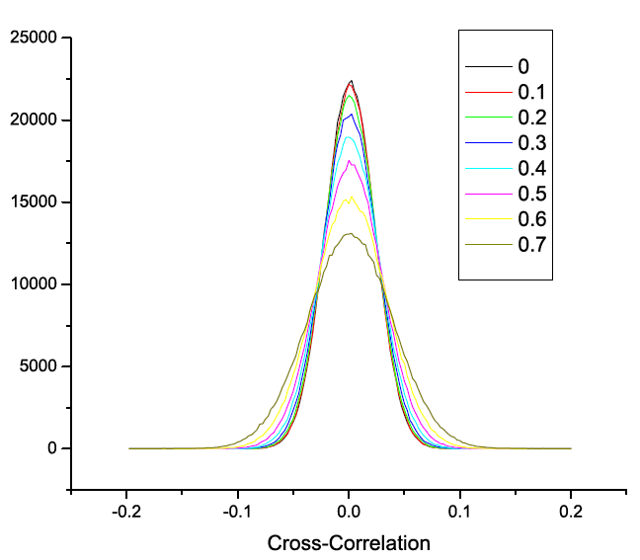
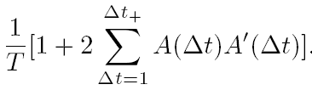
Correlation distribution for different AR(1) Coefficient
Variance of sample crosscorrelation
Variance
Notes:
Add a title

Slide 18

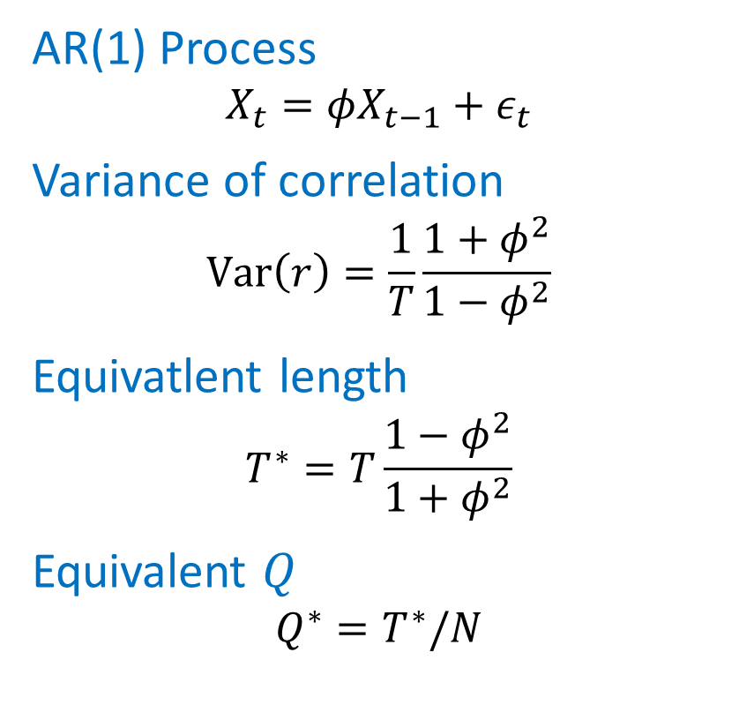
Eigenvalue distribution for different AR(1) Coefficient
Autocorrelation in time series may influence the eigenvalue distribution for uncorrelated time series
AR(1) Process
$$X_{t}=φX_{t−1}+ε_{t}$$
Variance of correlation
$$Var\left(r\right)=\frac{1}{T}\frac{1+φ^{2}}{1−φ^{2}}$$
Equivatlent length
$$T^{∗}=T\frac{1−φ^{2}}{1+φ^{2}}$$
Equivalent $Q$
$$Q^{∗}=T^{∗}/N$$
Wishart Matrix: $λ_{+}={\left(1+\sqrt{1/Q}\right)}^{2}$
Noise detected by RMT
Actual Noise
Eigenvalue to compare with empirical eigenvalues

Slide 19
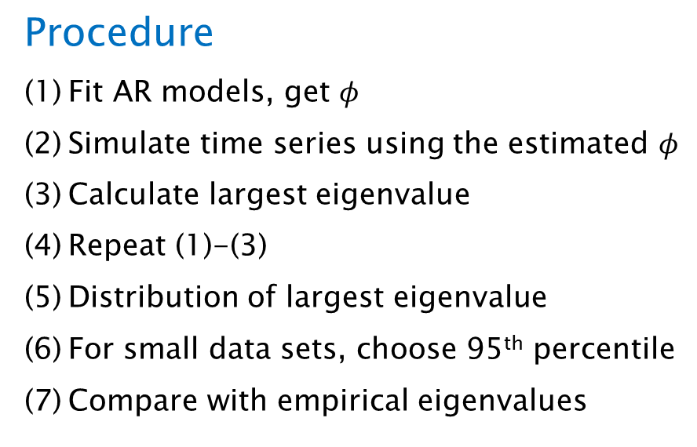
ARRMT: Summary
Aim
Adjust RMT for autocorrelated time series
Procedure
Fit AR models, get $φ$
Simulate time series using the estimated $φ$
Calculate largest eigenvalue
Repeat (1)-(3)
Distribution of largest eigenvalue
For small data sets, choose 95th percentile
Compare with empirical eigenvalues

Slide 20
Empirical Data: Is Autocorrelation Significant?
Data: Change of air pressure in 95 US cities
Histogram of AR(1) Coefficients

Slide 21
RMT and ARRMT for Daily Air Pressure of 95 US Cities
RMT
  11 significant factors
ARRMT
  8 significant factors

Slide 22


Time Lag Random Matrix Theory (TLRMT)
(Podobnik, Wang et. al., 2010, EPL.)
Aim: extend RMT to time lag correlation matrix
Unsymmetrical matrices, eigenvalues are complex numbers
Use singular value decomposition (SVD) instead of eigenvalue
Largest singular value: strength of correlation
Correlation matrix for lag=0 and lag=1
Lag=0 | GE | MSFT | JNJ
GE | 1 | 0.579 | 0.538
MSFT | 0.579 | 1 | 0.56
JNJ | 0.538 | 0.56 | 1
Lag=1 | GE | MSFT | JNJ
GE | 0.378 | 0.499 | 0.551
MSFT | 0.528 | 0.339 | 0.295
JNJ | 0.635 | 0.659 | 0.499
Notes:
Put formulars here. Left singular value, right singulare value.
Add matrix here.
Redo using graphs
Explain modifications
Functional dependence of correlations is the same as functional dependence of largest eigenvalue.

Slide 23
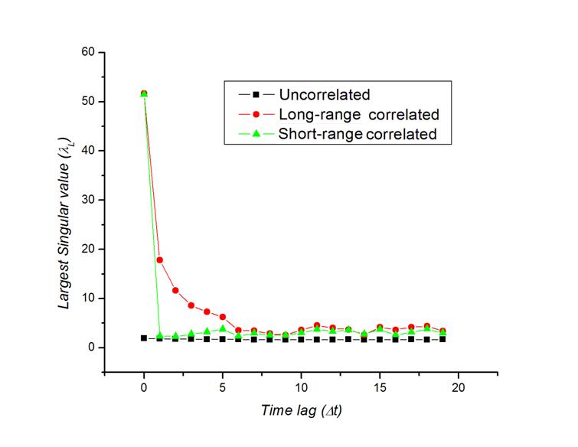
Time lag RMT:
Singular value vs time-lag cross-correlations
Notes:
What is the meaning of short range correlation?
Simulated data

Slide 24
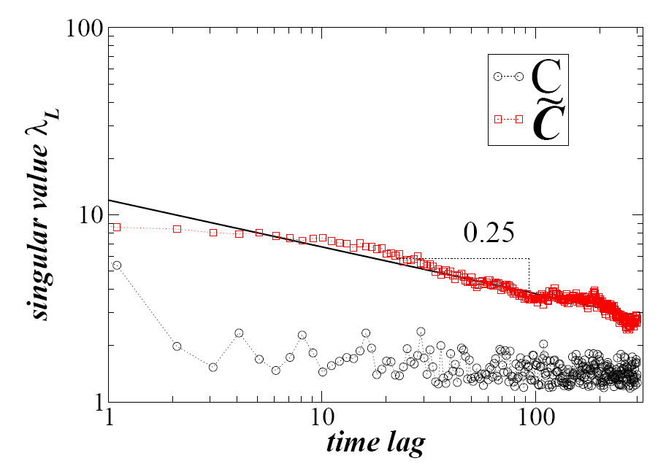
TLRMT Applied to 48 Stock Indices
We find:
Short-range return cross-correlations (after time lag=2)
Long-range magnitude cross-correlation (scaling exponent=0.25)
magnitudes
returns
Notes:
Should not decay faster. Persist longer.
What is L?
Graph bigger down left. Characters upperright. Title smaller.
There is a rectangle on the upper-right side of the graph, in order to mask characters.

Slide 25

Global factor model (GFM)
Wang et. al., 2011, PRE.
Aim: explain cross-correlations using one single process.
Assumption: Each individual index fluctuates in response to one common process, the “global factor” M_{t} .
What is the global factor?
A linear combination of all individual index returns
The weight of each index return is calculated using statistical method.
Measures dependence of R_{i,t} on M_{t}
individual return
Global factor
mean return
unsystematic noise
Notes:
Say first sentence.
In title, mention: mean field in finance.
Why M_t is mean field.
For example, people use sp500 as the mean field of us stocks.
When presenting this slide, try to emphasis on the difference between this model and linear regression.
Make it clear what is the global factor: a time series, linear combination of index returns.

Slide 26





GFM Properties:
Variance of global factor---- Cross-correlation among individual indices (holds for both returns and magnitudes)
Autocorrelation of global factor---- Time lag cross-correlation among individual indices
Conclusion:
Cross-correlation among individual indices decay in the same pattern as the autocorrelation of the global factor.
Return cross-correlation
Magnitude cross-correlation
A_{M} = autocorrelation of global factor
GFM explains the reason for the long range magnitude cross-correlations.
Notes:
Show that the model represents the data.
Par(mfrow=c(2,2))
SIMULATED global factor
Short range autocorrelaiont
Long range magnitude autocorrelation.
Reproduce the results from empirical analysis.
Go slow in this slide. Be sure to make the audience clear about the relationship between cross-correlation among indices and autocorrelation of the global factor.

Slide 27
Estimate of the global factor:
Principal Component Analysis (PCA)
Aim: Linear regression with unobservable M_{t}
Basis: Least total squared errors
Calculation: Eigenvalue decomposition (C=U⁺DU)
(1) The principal components are related with the eigenvectors.
(2) M_{t} = the first principal component
Procedure:
(1) Find M_{t} using eigenvalue decomposition.
(2) Linear regression, find μ, b_{i} , epsilon.
Unknown, linear combinition of R_{i,t}
Correlation matrix
Eigenvector matrix
Eigenvalue matrix
Notes:
Not simple linear regression. Because M unknown.
Only know that M is linear combo of R, but do not know each weights.
PCA to calculate weight of each R_i, and therefore calculate M
Linear regression to find the coefficients.
UNKNOWN!! (difference between PCA and simple linear regression.)
fast
Make a backup slide, and include these contents:
PCs definition (one simple equation here)
PC property 1: not correlated
PC property 2: explain largest percentage of variance
PC property 3: eigenvalue equals to variance of PC

Slide 28
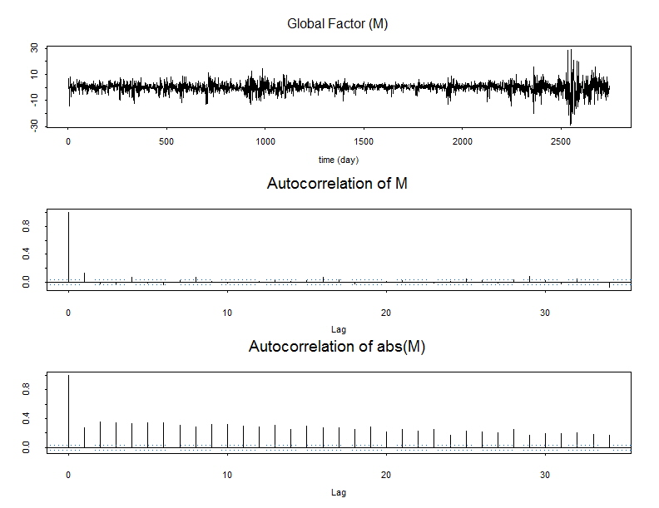
Estimate of the global factor: Result
Internet bubble
Subprime mortgage crisis
Notes:
Explains the reason why autocor and crosscor have the same properties.

Slide 29
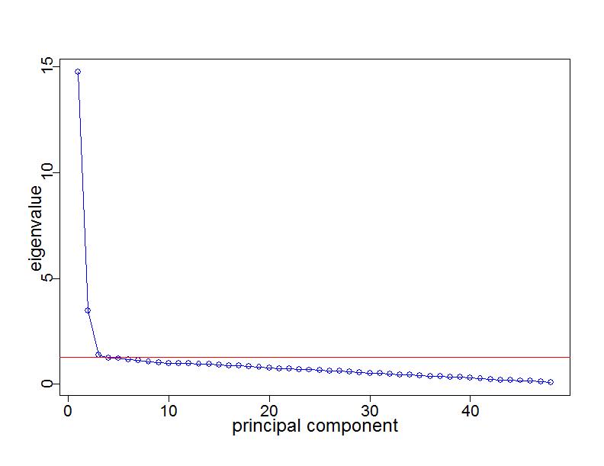
Significant test of Global Factor
Only 3 eigenvalues above Wishart maximum (significant).
The largest eigenvalue (global factor) constitute 31% of total variance, and 75% of total variance of 3 significant principal components.
Conclusion: the single global factor is sufficient in explaining correlations.
Eigenvalues above and below Wishart maximum.
Global factor
3 eigenvalues above Wishart maximum
Insignificant principal components
(eigenvalues below Wishart maximum)
Wishart maximum
Notes:
Wishart max
Add a line: zero
Use 4 different colors: graph, abline for Wishart max, abline for zero, and captions.

Slide 30
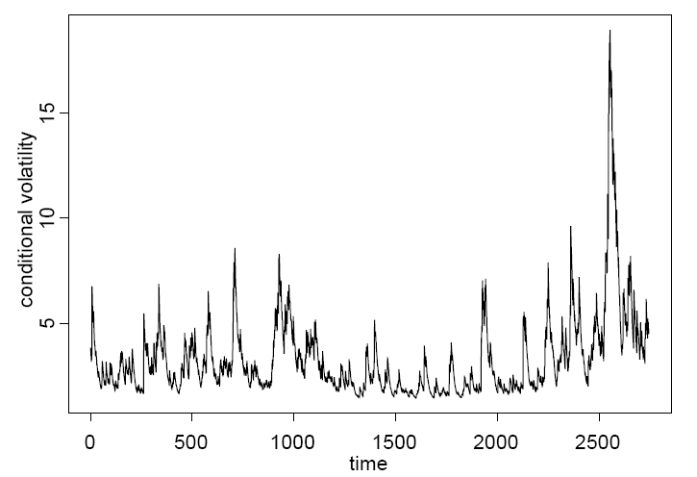
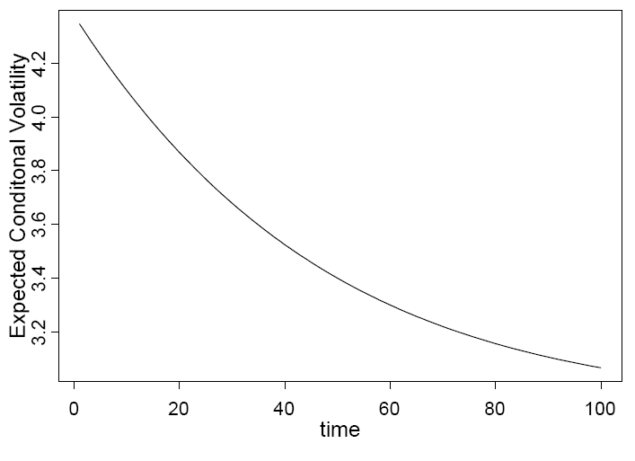
Application: risk forecasting
Define risk: volatility (time dependent standard deviation)
volatility=expected standard deviation of a time series at time t given information till time t-1.
How to calculate risk: Apply GARCH to global factor
Coefficients estimated using maximum likelihood (MLE)
Forecasted using recursion with estimated coefficients
Historical risk and expectation of future risk
Notes:
Skip this part. Too much math. MLE, GARCH.
Explain how to use MLE.
When I say time dependent standard deviation, go back to the global factor graph.
Use GJR-GARCH(1,1) instead of (p,q)
Do it like slide GFM. Use arrows instead of large amount of sentences.
(1) Tomorrow’s conditional volatility can be forecasted using today’s volatility.
(2) Estimate the coefficients using maximum likelihood (MLE), then use the estimated coefficients in forecasting.

Slide 31
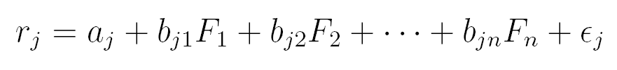
Application:
Multiple Global Factors
Wang et., al., working paper.
PC1: American and EU countries
PC2: Asian and Pacific countries
PC3: Middle east countries
Statistically, the world economy can be grouped as 3 sectors.
Global factor
Sectors
3 significant principal components (PCs)
Notes:
The world economy can be grouped as 3 subunits.

Slide 32
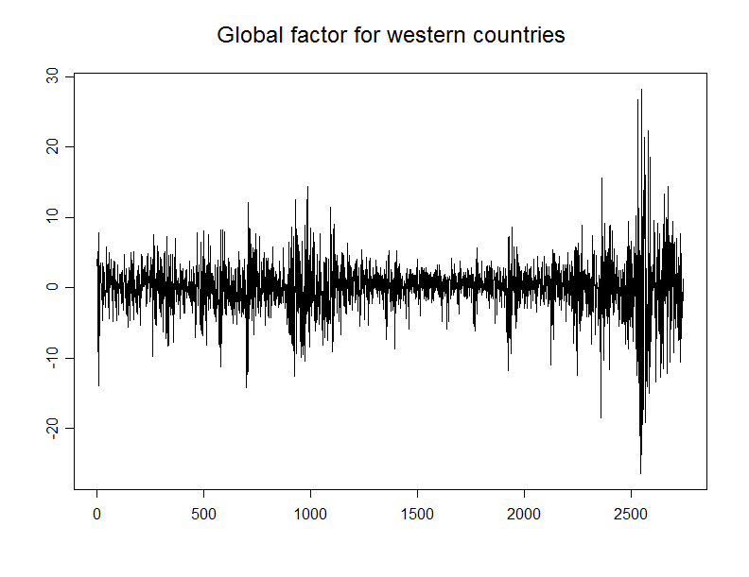
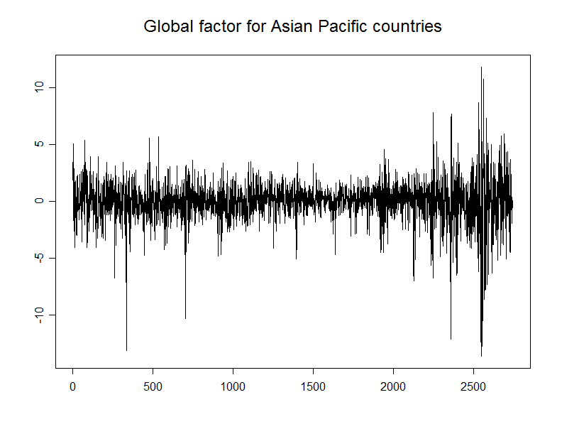
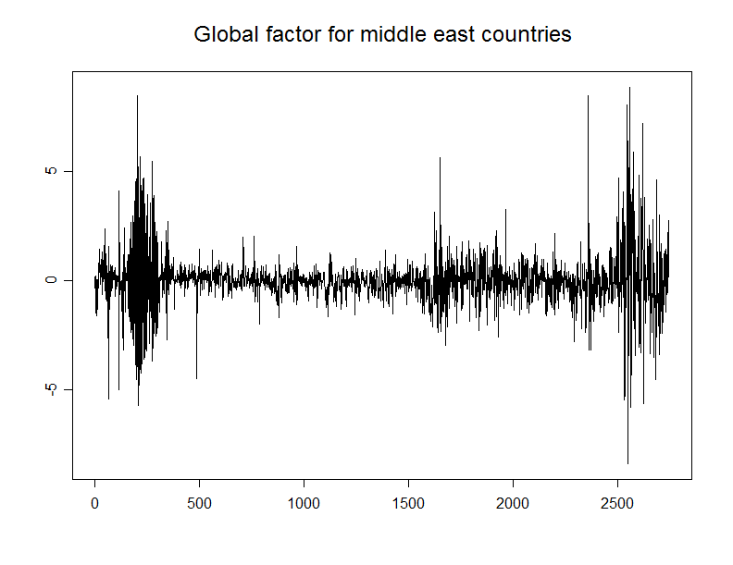
Multiple Global Factors: Western, Asian and Pacific, and Middle East
Large correlation between
Western and Asian economies
(2) Small correlation between Middle East
Economy and the other 2 groups
(3) Each group has its own financial crises.
(4) The 2008 market crash influenced all
3 groups, indicating globalization
(large volatility correlation).

Slide 33
Thanks for listening!
Duan Wang
wangduan@bu.edu
Notes:
Physiology diagonosis:
the same as finance
time series
same logic
know what are those time series, some in brain, some in eyes, heart beat,
1 second sample frequency
some electric signals,
diagnostics: most problbly, we can apply in diag purpose, health person and sick person, in epl, difference between good person in drunk person,
same as DFA, make distinction between sick and healthy person.
mean field:
parewise interactrons between nucleans,
in finance , parese beetween stocks,
it is complicated to analys parewise, complex, replace by simplif8id picture, each is influenced by mean field, interaction of all other nucleans of one nuclean.
In stock, same , SP500 is mean field of US stock market.
essence: complex picture be replaced by simplefied picture evey by mean field.
effective potential. potential berrieer.
For example, oxygen, there are 16 nucleans in the nuclear. the pairwise interactions will be complicated. However, the effect of the complicated interactions is: energy level for each nuclean, shortrange and strong attractive force, which restrict the nucleans not to escape. Therefore, we simplify it to a mean field, and the mean field is a potential barrier to prevent the nucleans from escaping. And each energy level of the potential barrier has the similar effect as the combination of pairwise interactions.

Slide 34
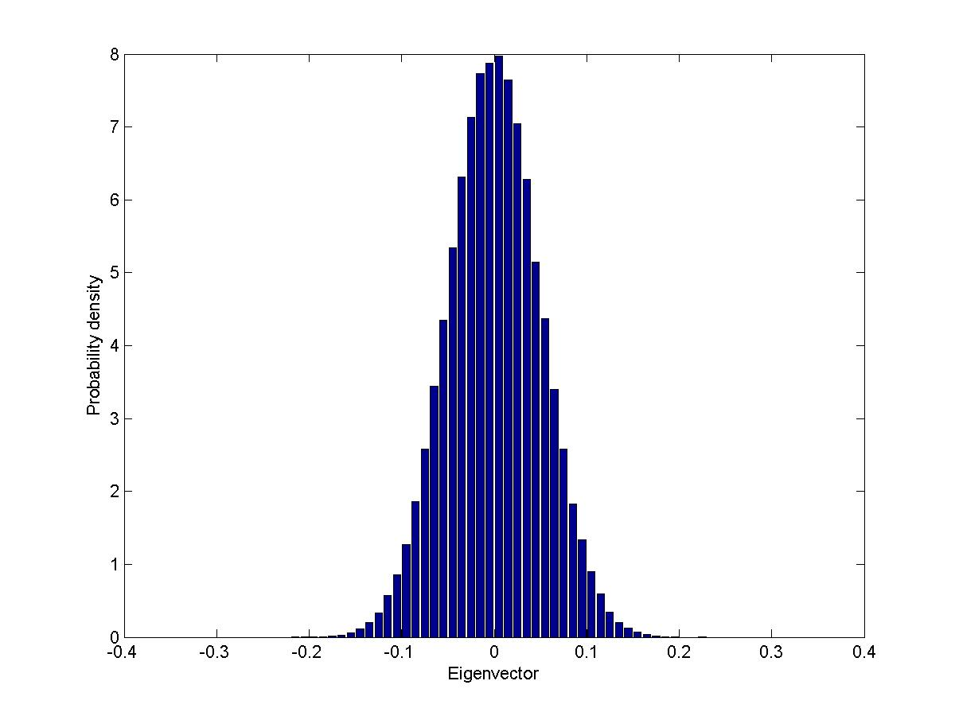
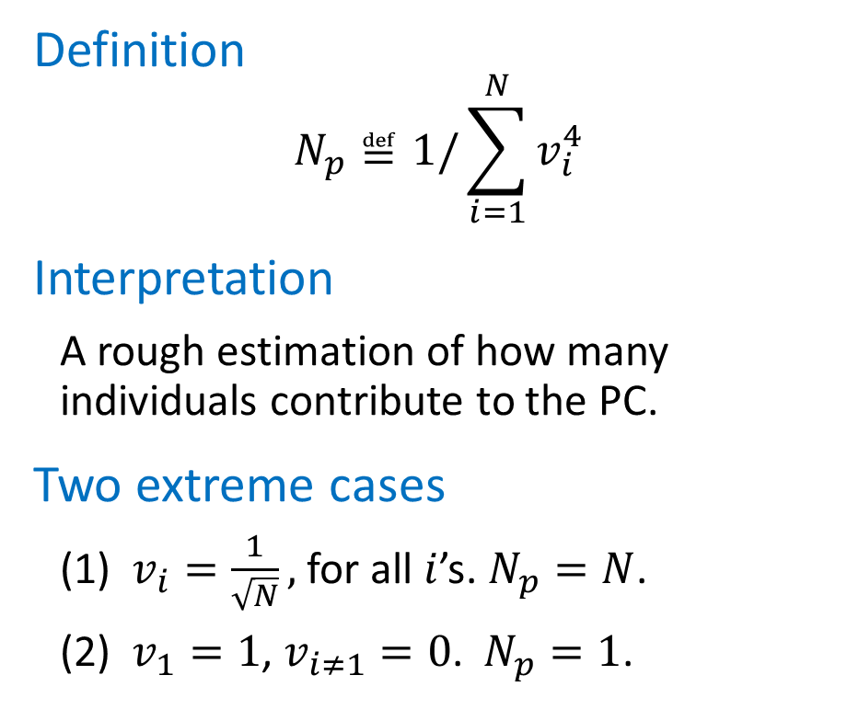
Eigenvectors: Implied Participation Number
Definition
$$N_{p}≝1/\sum_{i=1}^{N}{v_{i}^{4}}$$
Interpretation
A rough estimation of how many individuals contribute to the PC.
Two extreme cases
(1) $v_{i}=\frac{1}{\sqrt{N}},$ for all $i$’s. $N_{p}=N$.
(2) $v_{1}=1$, $v_{i≠1}=0$. $N_{p}=1$.
For Wishart matrix
Notes:
Mention IPR, my definition is easier to understand

Slide 35
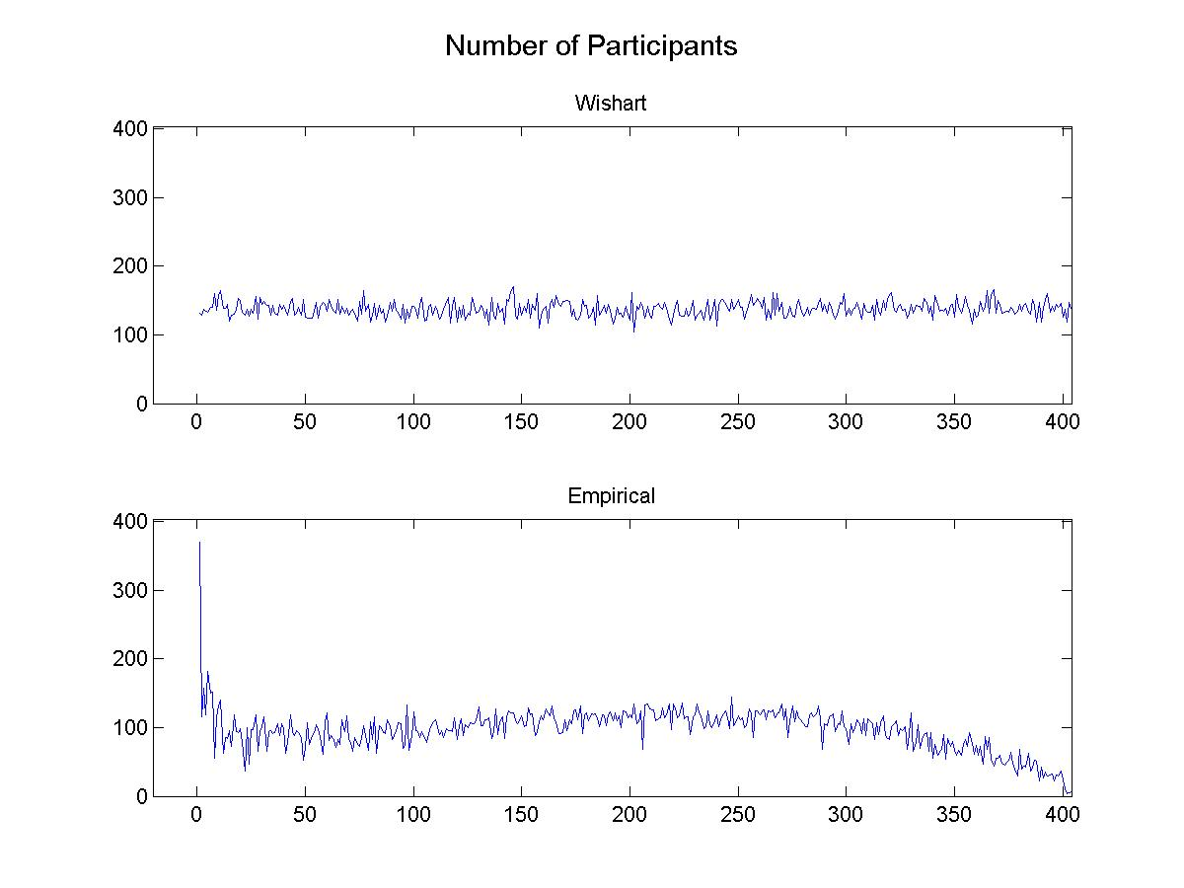
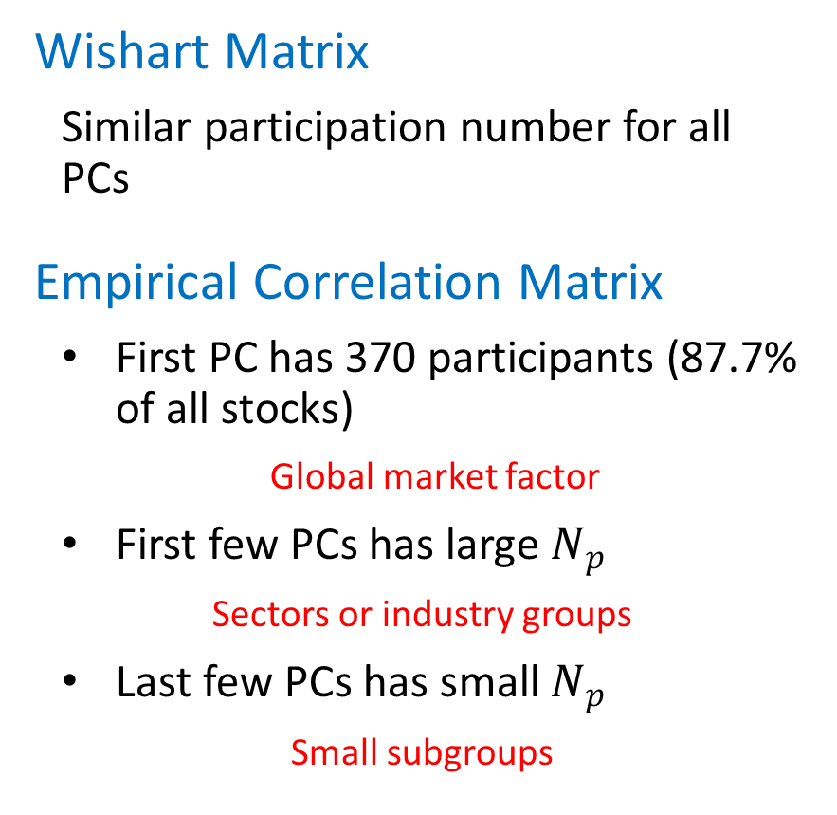
Empirical Implied Participation Number
422 stocks from S&P 500, 1737 daily returns
Wishart Matrix
Similar participation number for all PCs
Empirical Correlation Matrix
First PC has 370 participants (87.7% of all stocks)
Global market factor
First few PCs has large $N_{p}$
Sectors or industry groups
Last few PCs has small $N_{p}$
Small subgroups

Slide 36
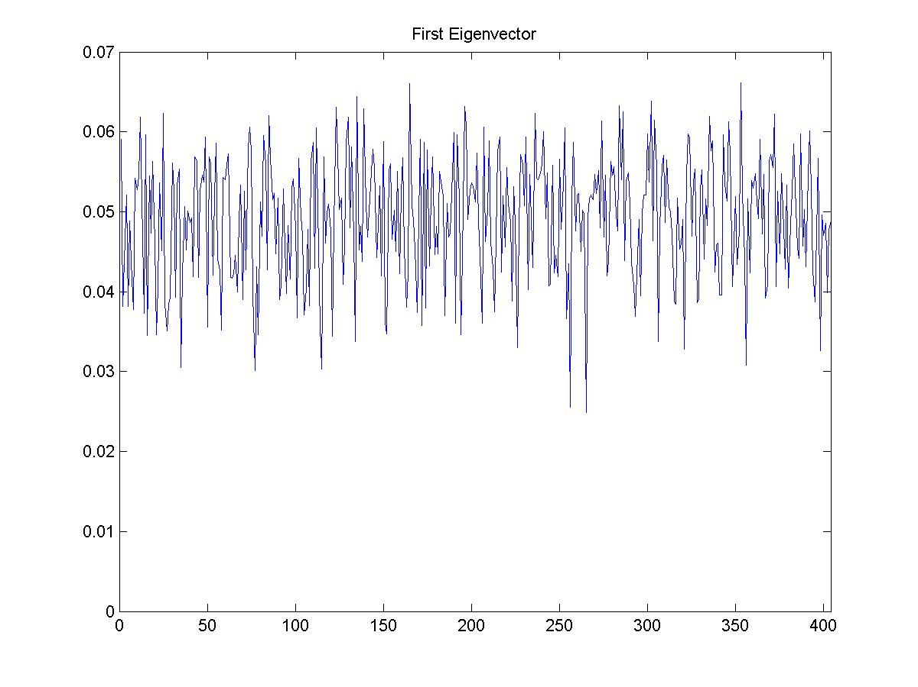
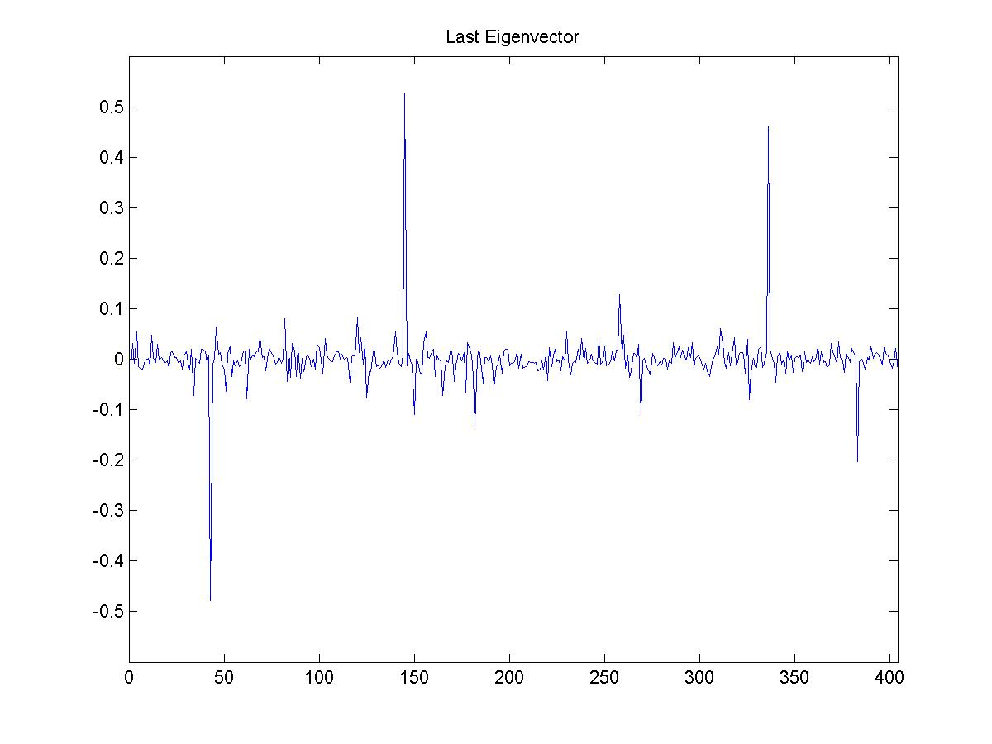
Empirical Implied Participation Number
First Eigenvector
Last Eigenvector
All positive, similar weights
Indicating global factor
Small number of participants
Indicating small subgroup
EQR
SPG
VNO
AVB

Slide 37
Efficient Frontier
H. Markowitz (1952)
Given:
Individual return $μ$, Covariance matrix $Σ$, Portfolio return $μ_{∗}$
Calculate:
Weigh $w_{eff}$ that minimize the portfolio risk $w^{T}Σw$
Calculate efficient frontier:
$$w_{eff}=\arg{\min_{w}{w^{T}Σw}}$$
Subject to
$$w^{T}μ= μ_{∗}, w^{T}1 = 1$$
Solution:
$$A=μ^{T}Σ^{−1}1$$
$$B=μ^{T}Σ^{−1}μ$$
$$C=1^{T}Σ^{−1}1$$
$$D=BC−A$$
$$w_{eff}=\left\{BΣ^{−1}1−AΣ^{−1}μ+μ_{∗}\left(CΣ^{−1}μ−AΣ^{−1}1\right)\right\}/D$$
$$w_{minvar}=Σ^{−1}1/C$$
Notes:
Add a slide: Diversification. Use GLD and SPY as an example. The return is still better than money market.

Slide 38
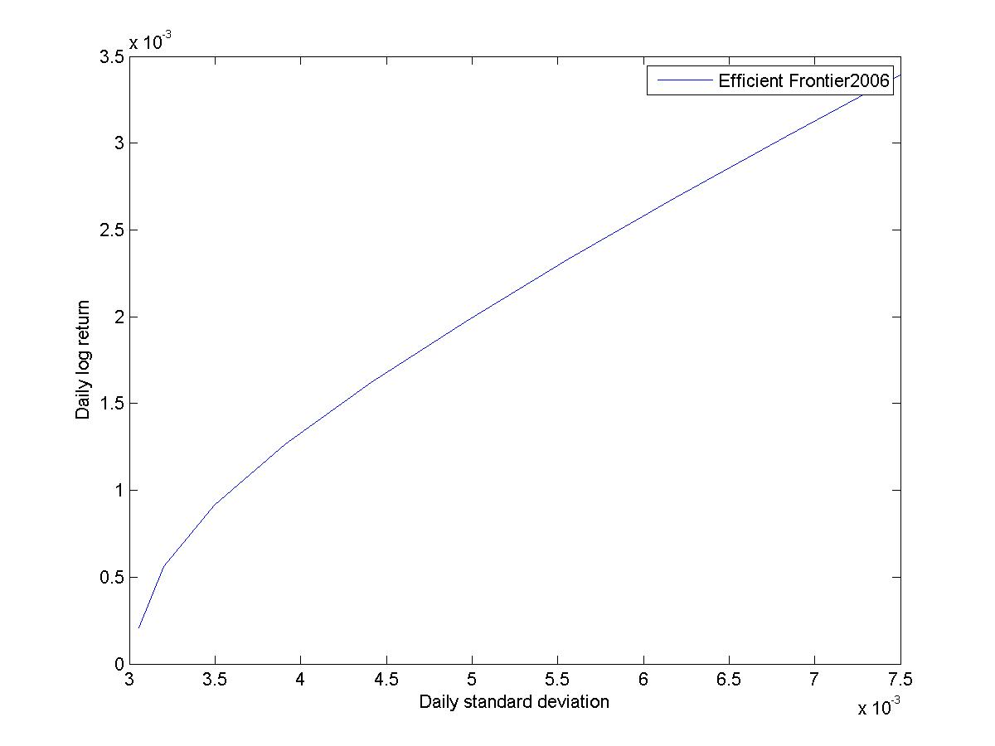
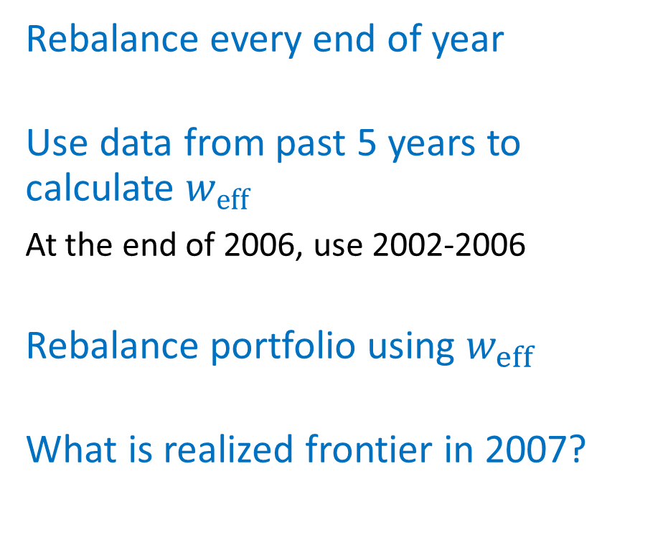
Example: 404 stocks from S&P 500
Rebalance every end of year
Use data from past 5 years to calculate $w_{eff}$
At the end of 2006, use 2002-2006
Rebalance portfolio using $w_{eff}$
What is realized frontier in 2007?

Slide 39
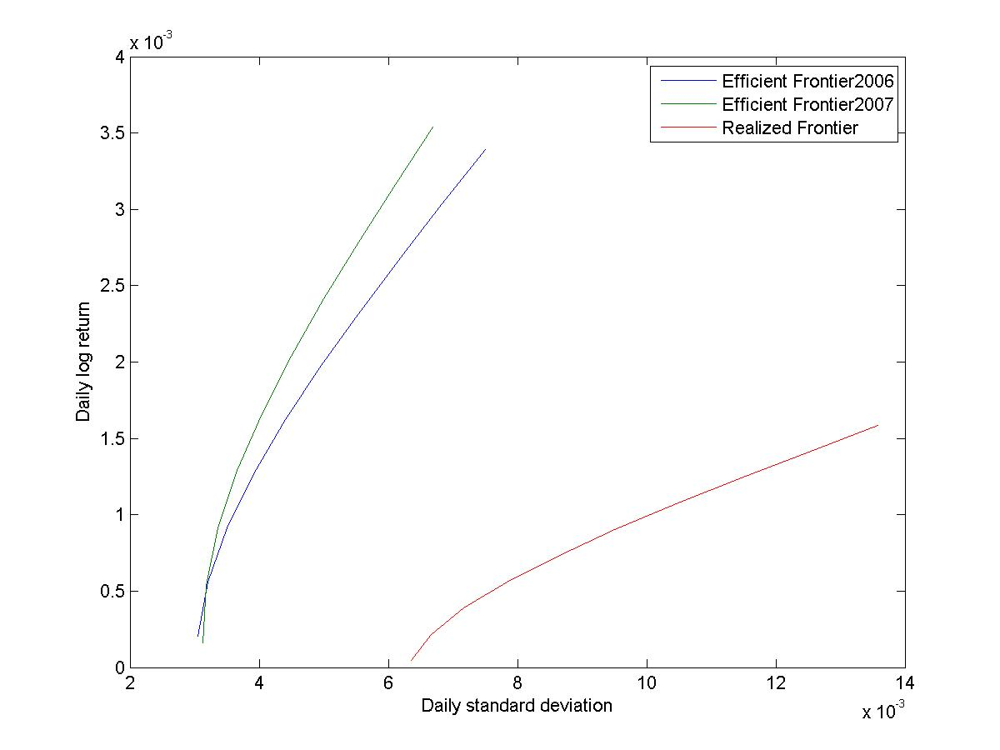
Example: 404 stocks from S&P 500
Rebalance every end of year
Use data from past 5 years to calculate $w_{eff}$
At the end of 2006, use 2002-2006
Rebalance portfolio using $w_{eff}$
What is realized frontier in 2007?
Problem: in sample estimate of the weights
does not minimize the out of sample error

Slide 40
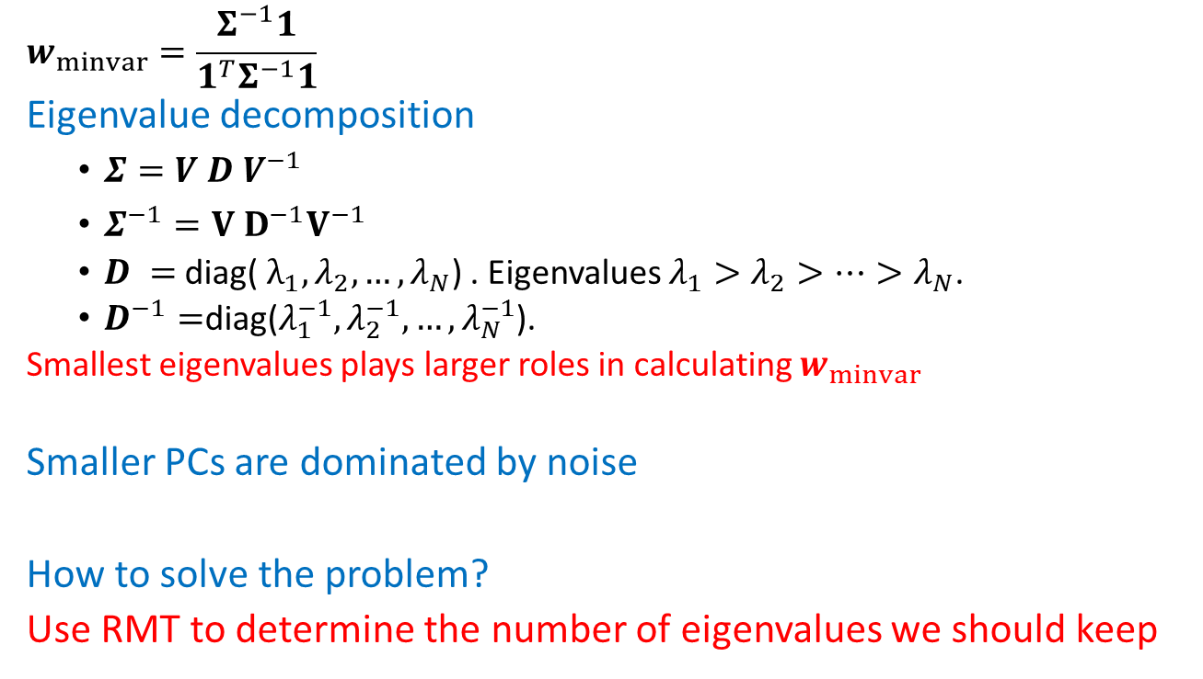
Reason for Instability
$$w_{minvar}=\frac{Σ^{−1}1}{1^{T}Σ^{−1}1}$$
Eigenvalue decomposition
$Σ=V D V^{−1}$
$Σ^{−1}=V D^{−1}V^{−1}$
$D =$diag( $λ_{1}, λ_{2}, …, λ_{N}$) . Eigenvalues $λ_{1}>λ_{2}>…>λ_{N}$.
$D^{−1}=$diag($λ_{1}^{−1}, λ_{2}^{−1},…, λ_{N}^{−1}$).
Smallest eigenvalues plays larger roles in calculating $w_{minvar}$
Smaller PCs are dominated by noise
How to solve the problem?
Use RMT to determine the number of eigenvalues we should keep

Slide 41
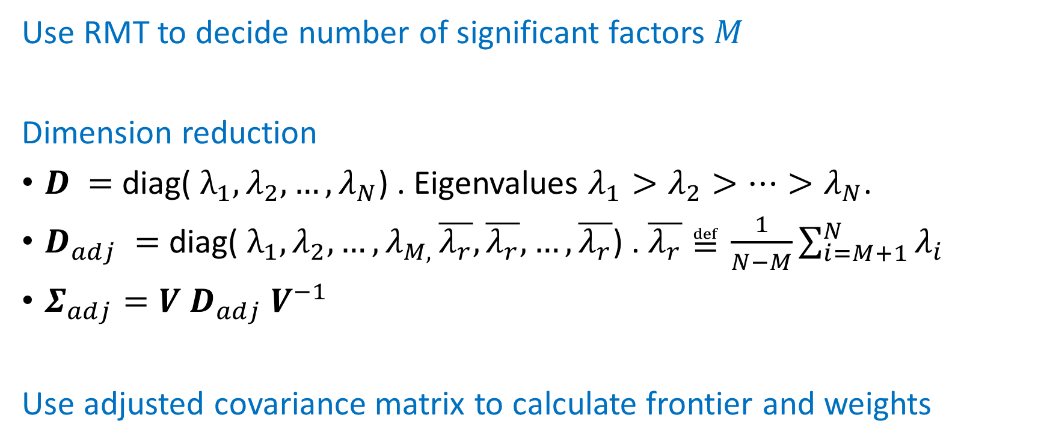
RMT in Portfolio Optimization: Procedure
Use RMT to decide number of significant factors $M$
Dimension reduction
$D =$diag( $λ_{1}, λ_{2}, …, λ_{N}$) . Eigenvalues $λ_{1}>λ_{2}>…>λ_{N}$.
$D_{adj} =$diag( $λ_{1}, λ_{2}, …, λ_{M, }\overline{λ_{r}},\overline{λ_{r}}, …,\overline{λ_{r}}$) . $\overline{λ_{r}}≝\frac{1}{N−M}\sum_{i=M+1}^{N}{λ_{i}}$
$Σ_{adj}=V D_{adj} V^{−1}$
Use adjusted covariance matrix to calculate frontier and weights
Notes:
Add a formula here.

Slide 42
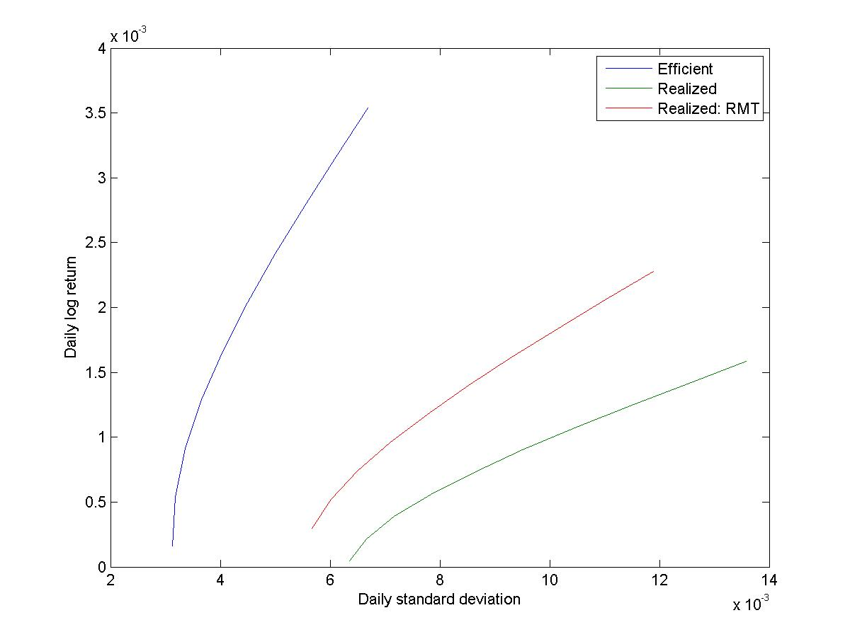
Realized Frontier: RMT Applied

Slide 43
Minimum Variance Portfolio:
Cumulative Return
 | μ | σ
Markowitz | 0.0001443 | 0.0086652
RMT | 0.0002205 | 0.0080505
After Applying RMT in constructing the minimum variance portfolio, we increased returns and reduced risk.
Notes:
Most of the difference come from year 2008-2009. During financial crisis, the correlation become less stable. Get a graph of eigenvalue vs time and find out how it looks like during crisis.

Slide 44
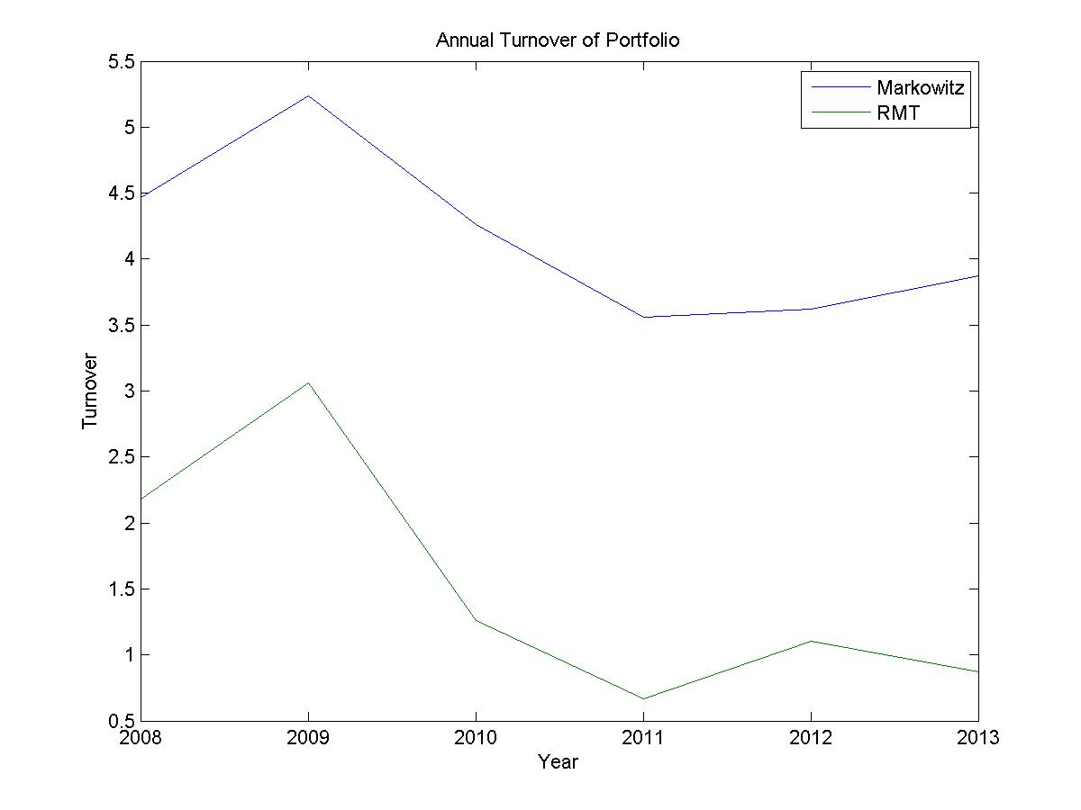
Minimum Variance Portfolio:
Turnover Rate
Notes:
Define turnover ratio before showing the graph.

Slide 45
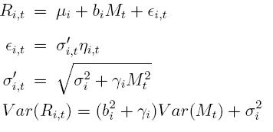

Other New Features in RMT
Time-lag RMT (TLRMT)
Global Factor Model (GFM)
Variance Crosscorrelation
Conditional Variance Adjusted Regression Model (CVARM)
Conditional Heteroskedasticity Adjusted Regression Model (CHARM)

Slide 46
Crosscorrelation Distribution vs AR(1) Coefficients
Variance

Slide 47


Largest Eigenvalue vs Autocorrelation
N=2000
T=8000

Slide 48

RMT for Small-Sized Data
95th Percentile
Notes:
Put formulars here. Left singular value, right singulare value.
Add matrix here.
Redo using graphs
Explain modifications
Functional dependence of correlations is the same as functional dependence of largest eigenvalue.

Slide 49
Other Possible Extensions:
RMT with existence of multicolinarity
RMT with N>T
(Show Figures Here!)

