Slide 1

Banking Systems under Network Theory
Case: Venezuela, 1998-2013
(in process)
Adam Avakian, Dror Y. Kenett, H. Eugene Stanley and Sary Levy-Carciente
April, 2014

Slide 2
Justification
The 2008 financial crisis proved we need new ways to think about systemic risk
  “Too big to fail” became “Too interconnected to fail”
  Current regulation stresses the health of the banks, i.e. nodes, but not of the network, i.e. the financial system, as a whole
Network theory helps expose the effect of connections between banks that can often lead to cascading failures not accounted for by traditional regulations

Slide 3
Questions
Can we predict the next financial crisis?
Can we prevent the next financial crisis?
Can we influence new financial regulations?

Slide 4
Our project
To describe the topology of the Venezuelan banking system based on Network Theory models
To explore and show the transformation of the system during the period 1998-2013 and better understand the effects of historical changes to bank laws
To simulate shock scenarios and evaluate their impacts

Slide 5
Data & Method
Data:
Balance Sheet information of each of the institutions of the banking system in monthly basis, from 1998-2013
Method:
Modeling a Bipartite Network: Assets-Banks
Simulation of shock scenarios

Slide 6
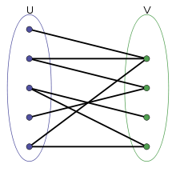
Bipartite networks
Edges only exist across two subsets of nodes

Slide 7
Bipartite networks
Edges only exist across two subsets of nodes

Slide 8
Bipartite networks
Edges only exist across two subsets of nodes

Slide 9
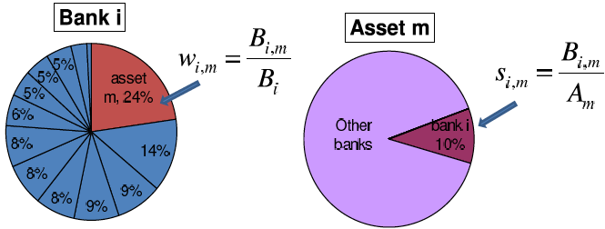
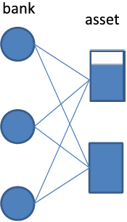
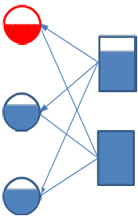
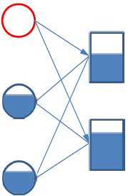
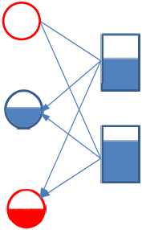
Cascading Failure Model
Images Courtesy of
Xuqing Huang
Notes:
Banks are interconnected in many ways, i.e. interbank loans. We only consider the liquidity risk. Which means, when a bank can’t meet its liability and fails, it needs to sell its assets to meet the liability. If the market can’t absorb the sale, then the value of this asset will decrease for a period.
Simulate the model with real data.

Slide 10
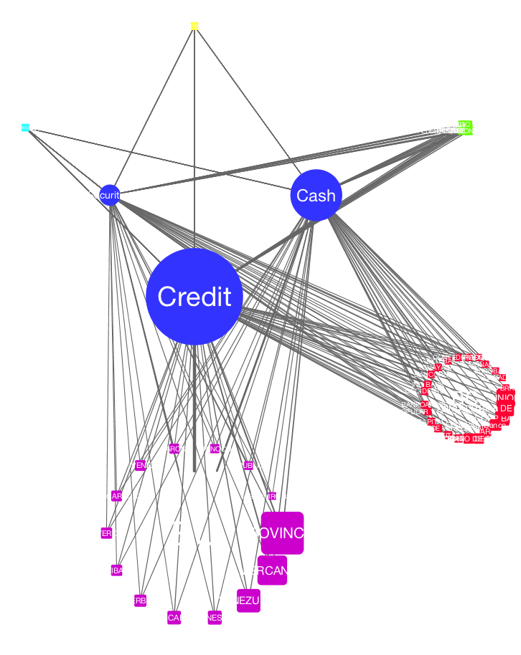
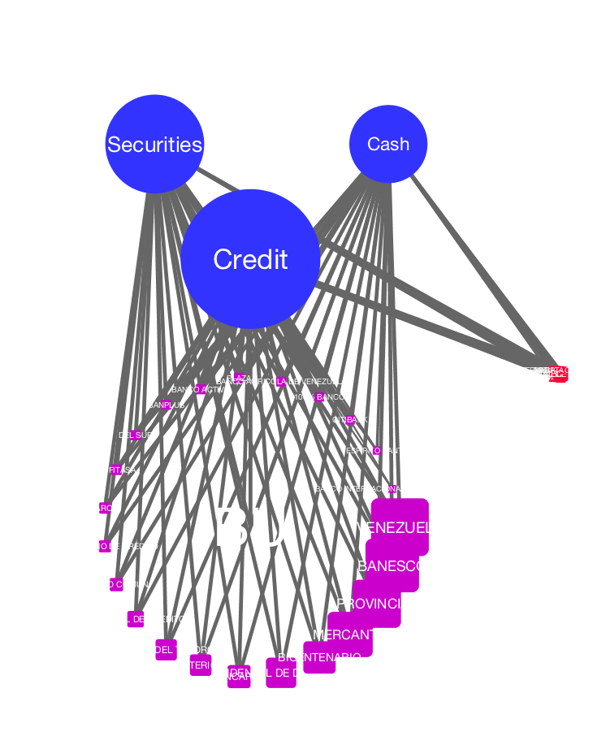
Asset Class Network
January 1998
December 2013

Slide 11
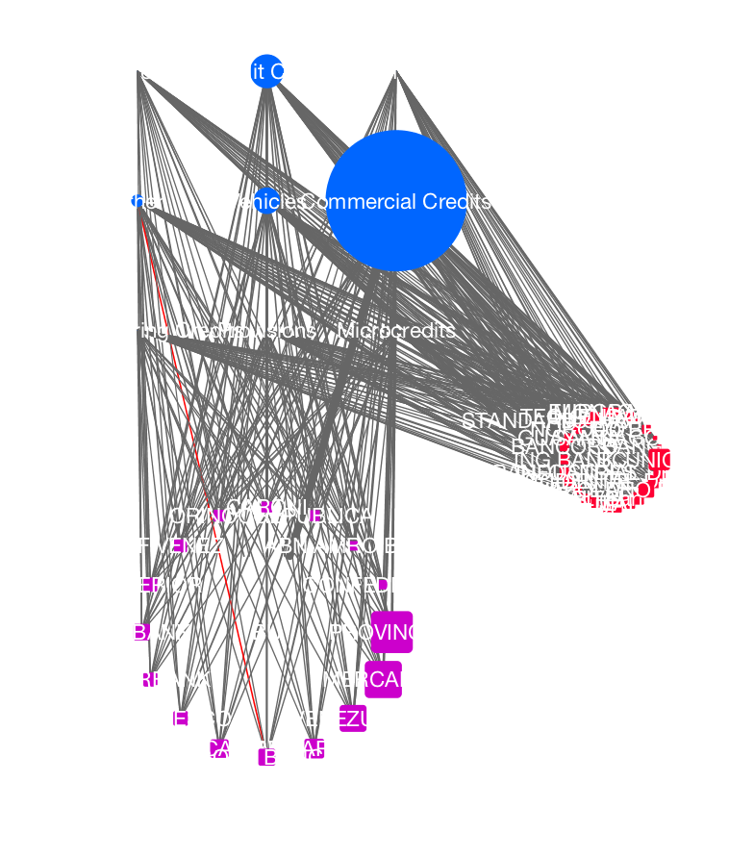
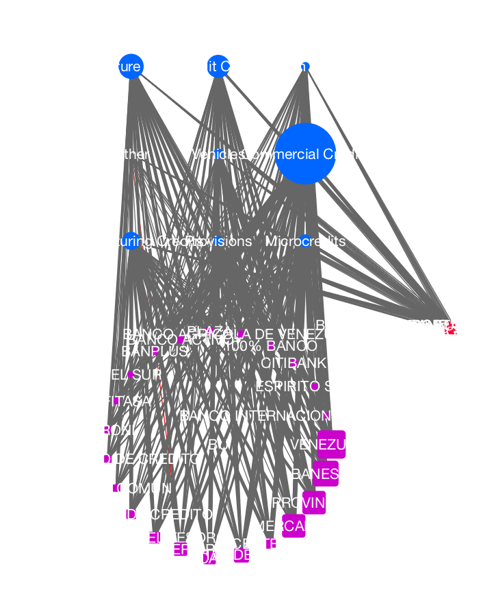
Credit Class Network
January 1999
December 2013

Slide 12
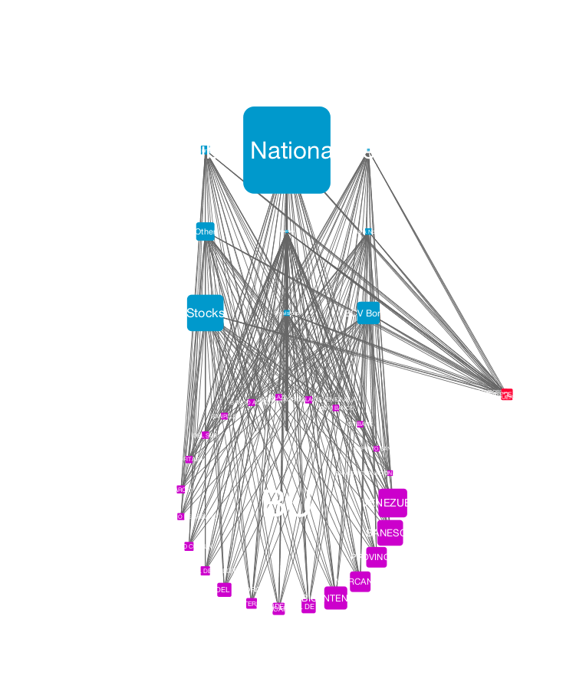
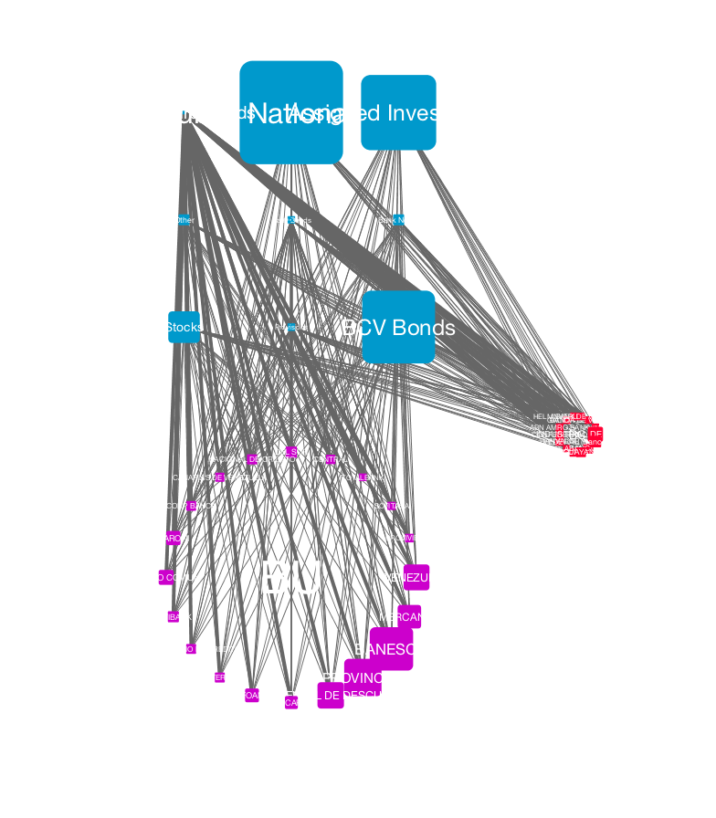
Security Class network
June 2005
December 2013

